Slide 1
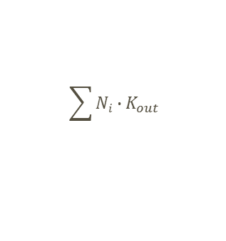
Updated Model with drug-related killing parameter
Comparison with previous model – new model
K_{death}
1. H9c2
K_{in}
E_{Kin}
8. Trypomastigotes
(TR)
E_{Kdeath}
7. Amastigotes
(AM)
K_{prot}
$$\sum{Ni}∙K_{out}$$
TR∙K_{prot}
N₀
K_{out}
2. iH9c2
N₁
N₄
E_{Kout}
E_{Kout}
E_{Kout}
N_{i}
K₂
K_{out}
K_{out}
3. S₁
K₁
4/5. S_{3/4}
6. S₄
K₁
E_{K1}
E_{K1}
E_{K1}
Intracellular parasite development delay

